Slide 1
Raspberry pi Internet of things L04 P01 W06 Node-RED
Samen Da Vinci

Slide 3
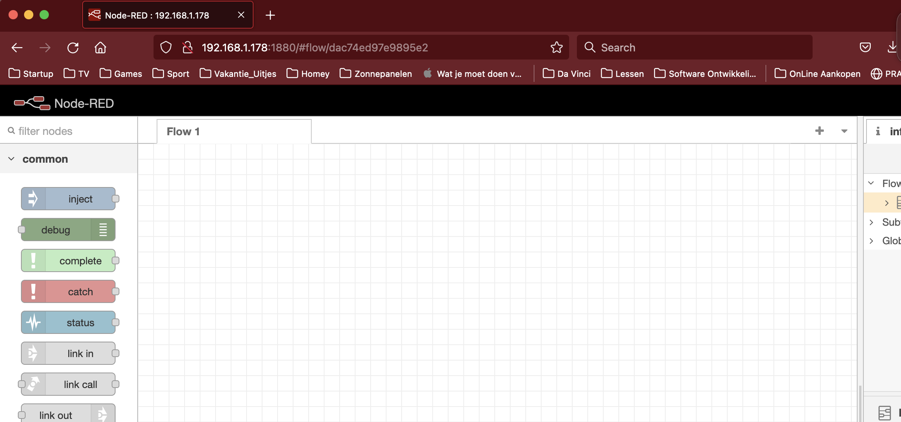

Slide 4
Vragen ?????

